Slide 1
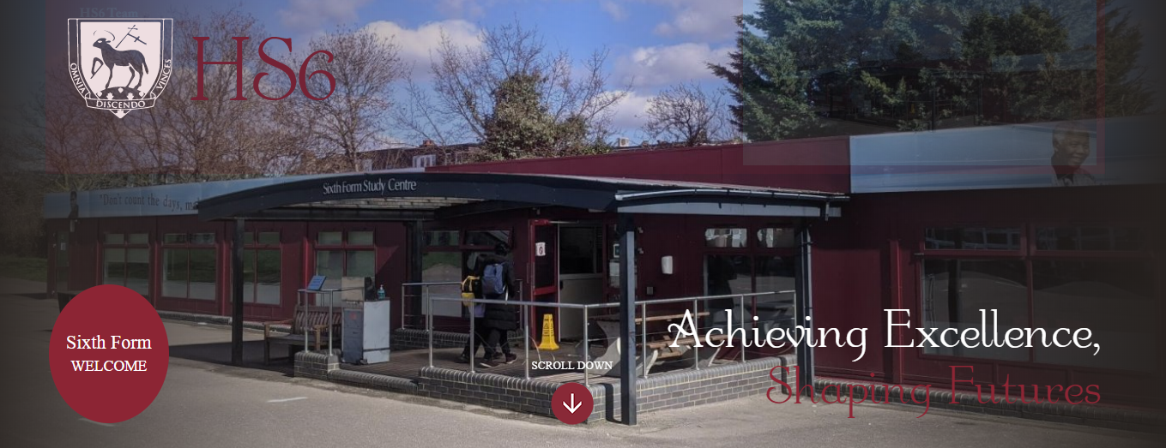
HS6 Induction 2021

Slide 2
What is Induction?
Induction is an opportunity to experience being a student at Hendon Sixth Form (HS6).
The objective is to strengthen the transition from GCSE (KS4) to A Level (KS5). We want to make sure you are in the best position to choose the right subjects and succeed from the start in September 2021.
This year we will offer a 1 week induction between Monday 21st June and Friday 25th June.
Even if you are not sure you want to stay next year we strongly advise attending the induction event to get a taste of the subjects you wish to study in KS5!
Induction is much more than just attending lessons. There will be opportunities for teambuilding, developing study skills, enrichment and starting the summer transition work for A Level!

Slide 3
What is the plan?
Mon 21st | 9.05 | Arrival / Sign in / timetable collected / tea & coffee
 | 9.35 | Welcome Assembly
 | 10:05 | Ice Breakers Sessions
 | 11:05 | Breaktime
 | 11:25 | Bock B Subjects – Maths / Sociology / Photography / Health and Social Care / Spanish / German
 | 12:25 | Block D Subjects – Japanese / Chemistry / Law / Geography / Art / French
 | 13:20 | Lunch
 | 14:10 | Block E – Psychology / Film Studies / Economics / IT / English Literarture
Tue 22nd | 09:05 | Block D Subjects – Japanese / Chemistry / Law / Geography / Art / French
 | 10:05 | Bock B Subjects – Maths / Sociology / Photography / Health and Social Care / Spanish / German
 | 11:05 | Breaktime
 | 11:25 | Block C – Physics / Travel and Tourism / Government & Politics / Performing Arts / RE
 | 12:25 | Block E – Psychology / Film Studies / Economics / IT / English Literarture
 | 13:20 | Lunch
 | 14:10 | Block A – Biology / Business / History / Sports Science
Wed 23rd |  | All day Enrichment Phasels Wood
Thu 24th | 09:05 | Block D Subjects – Japanese / Chemistry / Law / Geography / Art / French
 | 10:05 | Block A – Biology / Business / History / Sports Science
 | 11:05 | Breaktime
 | 11:25 | Bock B Subjects – Maths / Sociology / Photography / Health and Social Care / Spanish / German
 | 12:25 | Block E – Psychology / Film Studies / Economics / IT / English Literarture
 | 13:20
 | 14:10 | Block C – Physics / Travel and Tourism / Government & Politics / Performing Arts / RE
Fri 25th | 09:05 | Block A – Biology / Business / History / Sports Science
 | 09:55 | Block C – Physics / Travel and Tourism / Government & Politics / Performing Arts / RE
 | 10:45 | Breaktime
 | 11:05 | Presentation on EPQ / Closing Assembly
 | 11:55 | Private Study - Download and start the Summer Task / Feedback questionnaire
 | 12:45 | BBQ and goodbyes
All students will choose 4 different subjects they wish to experience and possibly study next year. Students choose one subject in 4 of the 5 blocks!
These subjects should closely match those discussed in your recent HS6 interview.
All students will have 3 lessons in each subject across the week.
On the Wednesday we will be taking all students to Phasels Wood to do outdoor pursuits and teambuilding activities.
The week will end with a celebration BBQ on Friday 25th June.

Slide 4
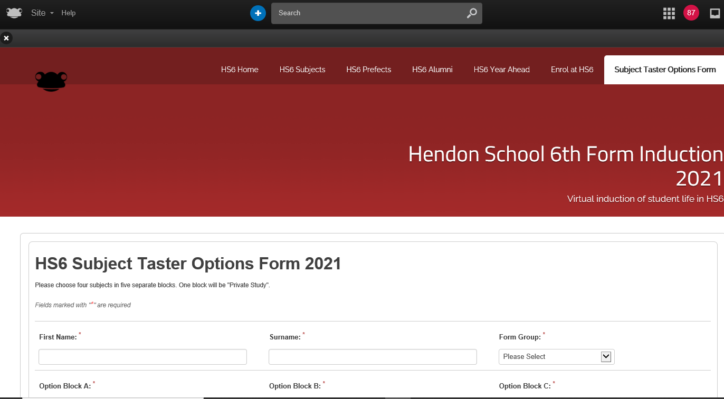
How do I sign up and choose my subjects?
You will sign up and make your 4 subject choices on the HS6 Induction site on Frog. There will be a link to this on the school website (click on Sixth Form) and on the year 11 site on Frog!
Tutors will also help you this week so you know where this is!
The HS6 induction site has lots of information about the different subjects we offer with taster videos, information PowerPoints and testimonials from former students. Please use this!
It also has links to the transition work (summer tasks) that you will begin working on during the induction week. These tasks ensure you are ready to hit the ground running when you start your new courses in September!
When you select your subjects on Frog please choose one subject in each block. In one block you must also choose private study. This gives you a total of 4 taster subjects. If taster sessions are full places will be allocated on a first come first served basis.
The deadline for making your choices and confirming your place at induction week 2021 is Friday 28th May.

Slide 5
Why study at HS6?
https://www.youtube.com/watch?v=QvMcu71zdeE

