Slide 1

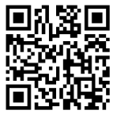
Everyone is welcome to attend
Hendon School Community Iftar
Wednesday 12th March
5.30-7pm
Maghrib prayer 6.03pm
A free ticket must be booked for each person attending the iftar
Ramadan Mubarak
Hendon School, Golders Rise, NW4 2HP
https://forms.office.com/e/A8vY3wY0Te

